Slide 1

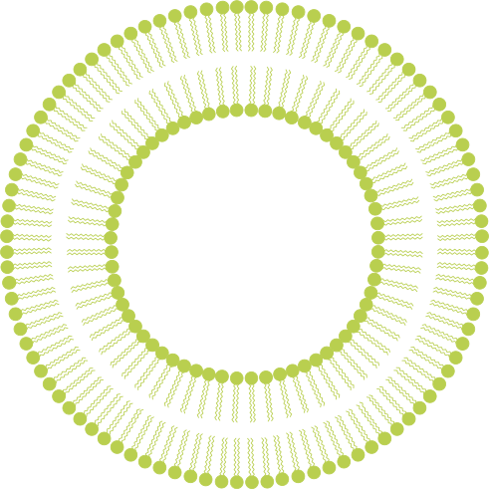
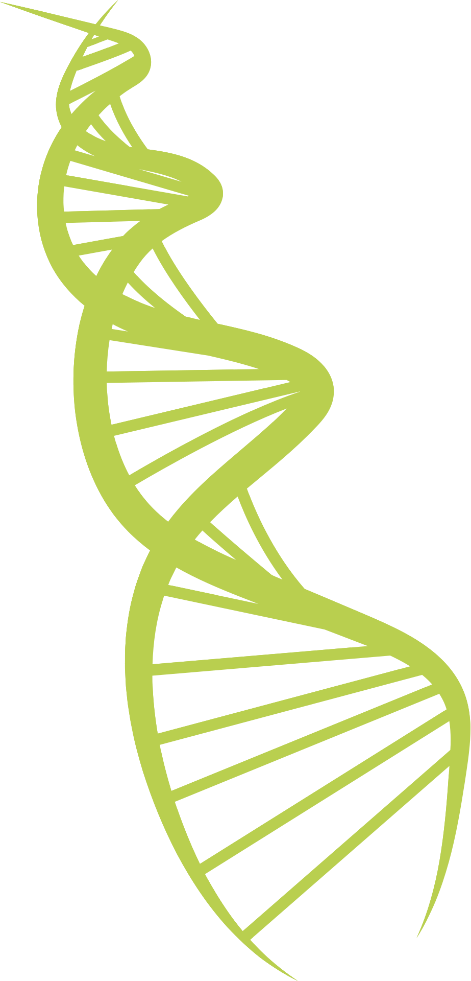
Neurons and Neural Communication
Neuronas y comunicación neuronal
The Building Blocks of the Nervous System
Los componentes básicos del sistema nervioso

Slide 2
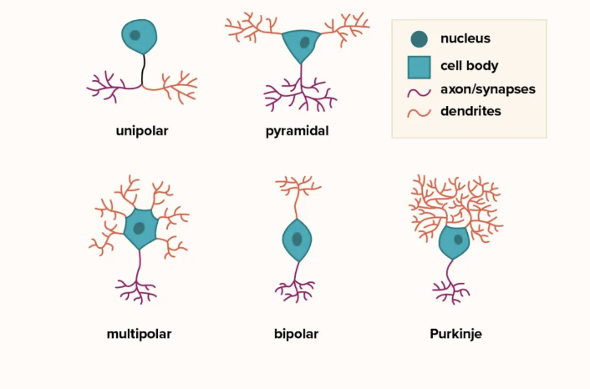
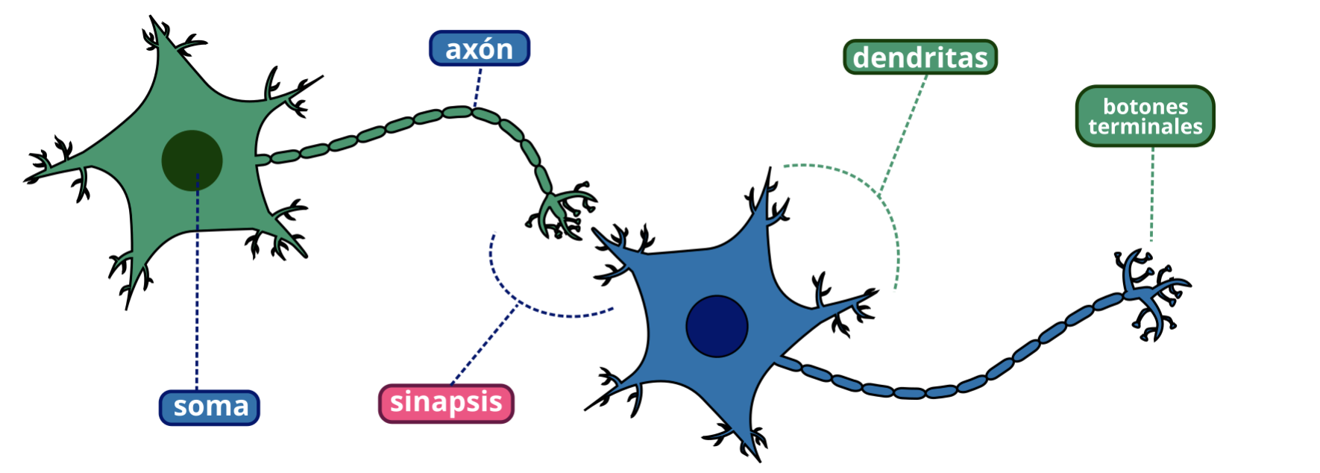
What are Neurons?
¿Qué son las neuronas?
Neurons are the functional units of the nervous system
Las neuronas son las unidades funcionales del sistema nervioso
They are specialized to receive, process, and transmit information
Están especializadas en recibir, procesar y transmitir información
Humans have about 86 BILLION neurons - this means TRILLIONS of connections!
Los seres humanos tenemos alrededor de 86 mil millones de neuronas, ¡lo que significa billones de conexiones!
Come in all shapes and sizes!
¡Las hay de todas las formas y tamaños!

Slide 3
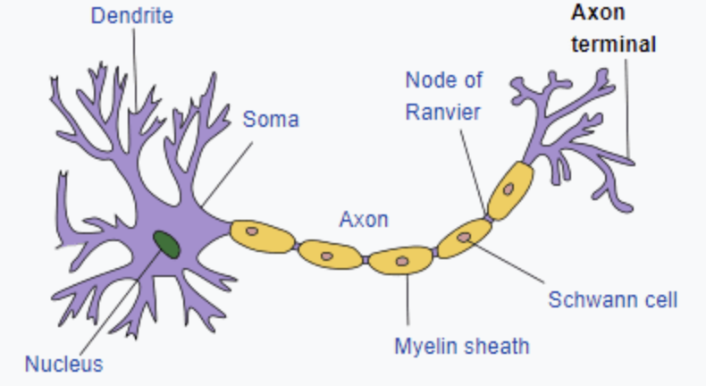
What are Neurons?
¿Qué son las neuronas?
Dendrita
Terminal axónica
Nódulo de Ranvier
Soma
Axón
Célula de Schwann
Vaina de mielina
Direction of Signal | Dirección de la señal
Núcleo
Notes:
The branch like extensions are called the dendrites, and they receive signals from other neurons
more dendrites = more connections
the soma, also known as the cell body, contains the nucleus and organelles. It is responsible for interpreting the incoming signals from the dendrites and will then send them down the rest of the neuron
the axon is the long slender projection of the neuron that transmits the signals from the neuron’s soma to the axon terminal to transmit the message
the myelin sheath is a fatty coating around the axon that is able to insulate and speed up the signals that are received. This helps protect the axon from damage and ensure that signals travel quickly and efficiently between neurons.
The Schwann cells form the myelin sheath around the axons, providing essential support for neurons.
The Nodes of Ranvier are the small gaps in myelin that enable the transmitted signal to jump from node to node. This also greatly increases the speed of the signal and requires less energy to transmit a signal.
At the other end of the neuron is the axon terminals, which is where it communicates with the dendrites of another neuron. When the signal reaches the end of the axon terminals, it triggers the release of chemical messengers called neurotransmitters into the synapse. These neurotransmitters will cross a synaptic gap and bind to the receptors on the next neuron, which we will go more in depth into.

Slide 4
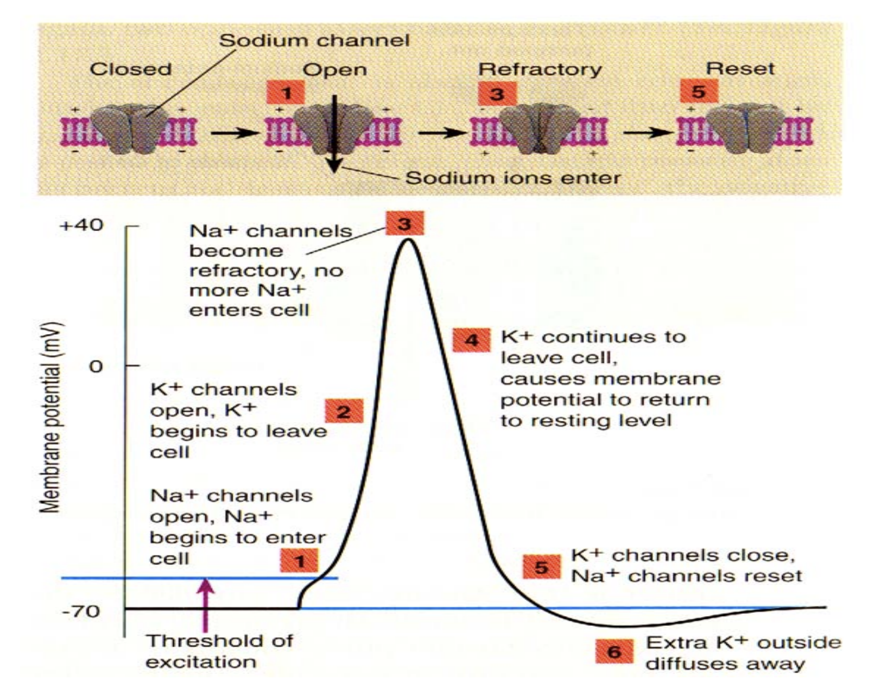
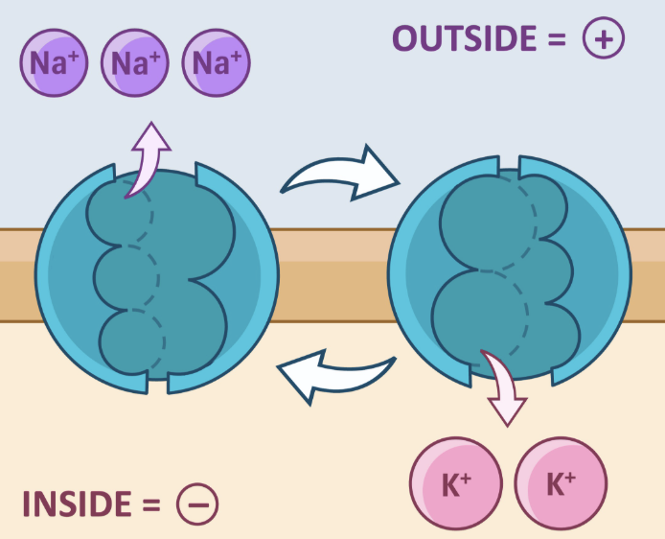
Na+/K+ Pump | Bomba de Na+/K+
Pump At Rest
Bomba en reposo
Afuera
Adentro
Notes:
These action potentials are regulated by sodium potassium pumps, which work to maintain the resting membrane potential and allow for depolarization and repolarization.
At rest, the pump actively transports 3 sodium ions out of the cell for every 2 potassium ions, makes the resting membrane potential negative
dont forget, ions have charge!

Slide 5
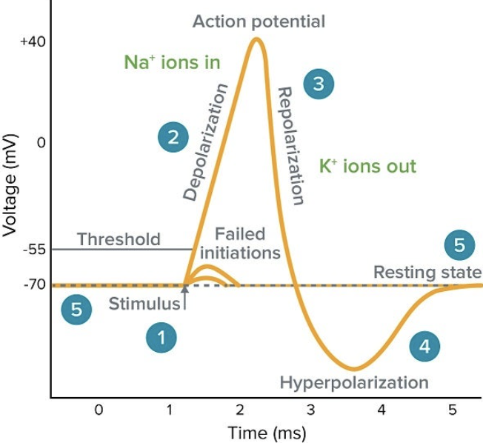
How a Neuron Fires | Cómo se activa una neurona
Neurons communicate with electrical impulses called action potentials
Las neuronas se comunican mediante impulsos eléctricos llamados potenciales de acción
Resting Potential: This is when the neuron is at rest, with a membrane potential of approximately -70 mV
Potencial de reposo: Este es el estado en el que la neurona está en reposo, con un potencial de membrana de aproximadamente -70 mV
iones Na+ dentro de la célula
Voltaje
iones K+ fuera
tiempo (ms)
Notes:
has a negative charge relative inside relative to the outside, known as the resting membrane potential (salty banana rmp)
Metaphor: A quiet room with a bouncer at the door

Slide 6
How a Neuron Fires | Cómo se activa una neurona
Depolarization: An external stimulus causes the neuron to reach its threshold potential, triggering a rapid rise in membrane potential
Despolarización: Un estímulo externo provoca que la neurona alcance su potencial umbral, lo que desencadena un rápido aumento del potencial de membrana
An all or nothing event | Un evento de todo o nada
iones Na+ dentro de la célula
Voltaje
iones K+ fuera
tiempo (ms)
Notes:
There is minimum stimulation needed to fire
Metaphor: A few excited fans gather at the door – pressure starts to build; the door flies open, and a rush of people enter the room

Slide 7
How a Neuron Fires | Cómo se activa una neurona
Action Potential: Sudden electrical impulses down the axon
Potencial de acción: Impulsos eléctricos repentinos a lo largo del axón
Peaks around +30 mV
Alcanza un pico de aproximadamente +30 mV
Membrane begins to repolarize
La membrana comienza a repolarizarse
iones Na+ dentro de la célula
Voltaje
iones K+ fuera
tiempo (ms)
Notes:
This electrical signal is triggered by the cell body of the neuron, which receives signals from the dendrites. The signal will then be sent down the rest of the neuron
This electrical signal is called an action potential
Metaphor: The room is packed and buzzing – almost too full; the bouncer begins to kick people out through a side exit

Slide 8
How a Neuron Fires | Cómo se activa una neurona
Hyperpolarization: The membrane potential drops briefly below the resting potential
Hiperpolarización: El potencial de membrana cae brevemente por debajo del potencial de reposo
Short reset time after firing so neurons cannot fire again immediately
El tiempo de recuperación tras la activación es corto, por lo que las neuronas no pueden activarse de nuevo inmediatamente
iones Na+ dentro de la célula
Voltaje
iones K+ fuera
tiempo (ms)
Notes:
ensures that the signal moves only in one direction from the dendrites to the axon terminals
also known as the refractory period
Metaphor: Security kicks out too many people

Slide 9
How a Neuron Fires | Cómo se activa una neurona
Resting State: The membrane potential returns back to the resting membrane potential and is ready to fire again
Estado de reposo: El potencial de membrana vuelve a su estado de reposo y está listo para volver a activarse
iones Na+ dentro de la célula
Voltaje
iones K+ fuera
tiempo (ms)
Notes:
Metaphor: Bouncer lets some more people back in to restore people

Slide 10
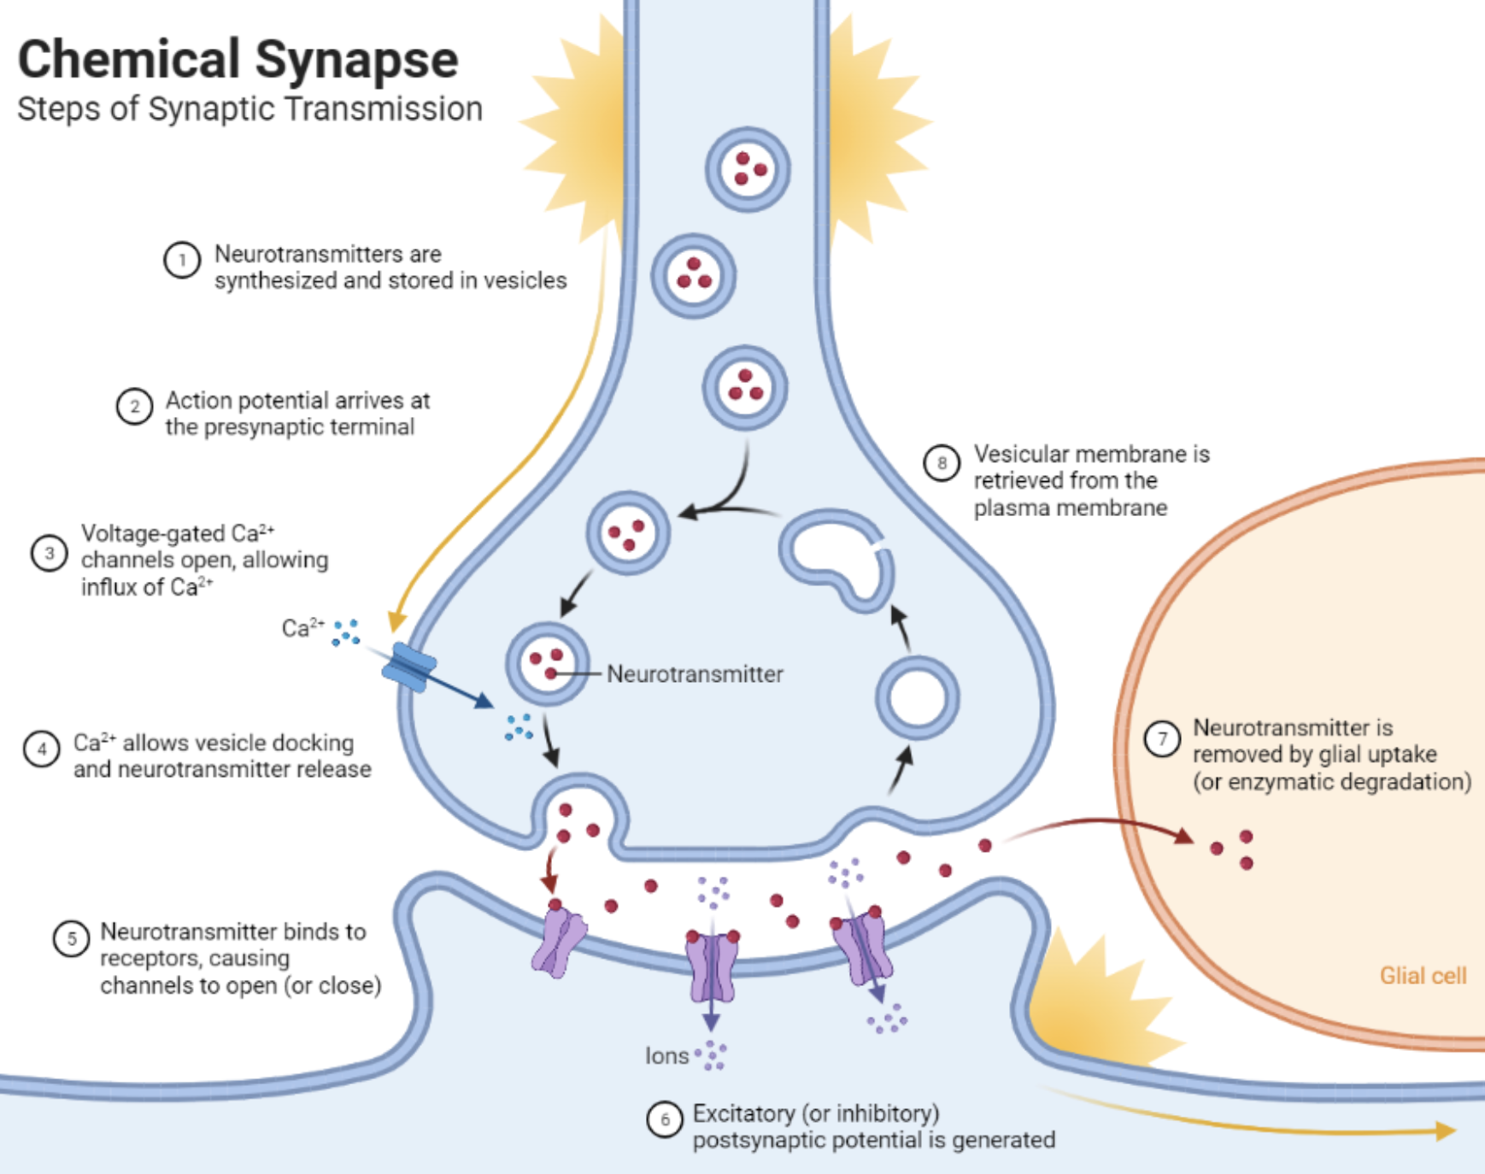
Chemical Communication Between Neurons
Comunicación química entre neuronas
Neurotransmitters are synthesized and stored in vesicles
Los neurotransmisores se sintetizan y almacenan en vesículas
Sinapsis química
Notes:
These synapses are at the end of the axon terminals

Slide 11
Chemical Communication Between Neurons
Comunicación química entre neuronas
Action potential arrives at the presynaptic terminal
El potencial de acción llega a la terminal presináptica
Sinapsis química
Notes:
This is the action potential that is carried down from the axon

Slide 12
Chemical Communication Between Neurons
Comunicación química entre neuronas
Voltage-gated calcium (Ca2+) channels open, allowing influx of Ca2+
Los canales de calcio (Ca2+) dependientes de voltaje se abren, permitiendo la entrada de Ca2+
Sinapsis química
Notes:
the arrival of the action potential also opens voltage gated calcium channels

Slide 13
Chemical Communication Between Neurons
Comunicación química entre neuronas
Calcium allows vesicle docking and neurotransmitter release
El calcio permite el acoplamiento de las vesículas y la liberación de neurotransmisores
Sinapsis química
Notes:
the calcium released flows into these synapses, moving these vesicles with neurotransmitters to the presynaptic cleft, which is at the bottom of synapse, and releasing them into the synaptic cleft, which is the space between the two synapses of the 2 neurons

Slide 14
Chemical Communication Between Neurons
Comunicación química entre neuronas
Neurotransmitter binds to receptors, causing the channel to open (or close)
El neurotransmisor se une a los receptores, provocando que el canal se abra (o se cierre)
Sinapsis química
Notes:
The released neurotransmitter molecules diffuse across the synaptic cleft to bind to receptors on the next neuron

Slide 15
Chemical Communication Between Neurons
Comunicación química entre neuronas
Excitatory (or inhibitory) postsynaptic potential is generated
Se genera un potencial postsináptico excitatorio (o inhibitorio)
Sinapsis química
Notes:
The signal that these neurotransmitters send will trigger a response in the postsynaptic neuron
This can involve opening different channels which will then directly change the neuron’s membrane potential, making it more (excitatory) or less likely (inhibitory) to fire its own action potential.
This is important because it allows for the precise balance of neural activity and proper response to stimuli. For example, we want excitatory action potentials when our neurons are transmitting an active signal, such as telling a muscle to contract or a brain region to process information fast. If it does not transmit information fast enough or at all, then we will have an imbalance and can lead to dysfunction. This can be seen in disorders like epilepsy, where an excess of excitation (too many action potentials) or a lack of inhibition can cause seizures

Slide 16

Chemical Communication Between Neurons
Comunicación química entre neuronas
Neurotransmitter is removed by glial uptake (or enzymatic degradation)
El neurotransmisor se elimina mediante captación glial (o degradación enzimática)
Sinapsis química
Notes:
Once the signal is properly transmitted to the postsynaptic neuron, the neurotransmitter must be cleared from the synaptic cleft to allow for new signals. This can happen by glial uptake, which is when a glial cell, which is responsible for clearing neurotransmitters quickly and efficiently, removes the neurotransmitters to prevent build up and toxicity in the neuron.
Neurotransmitters can also be removed by enzymatic degradation, where enzymes come into the synaptic cleft and terminate their actions and break them down.
The docked vesicles then are recycled back into the synaptic membrane and can be used again for when a new signal arrives.

Slide 17
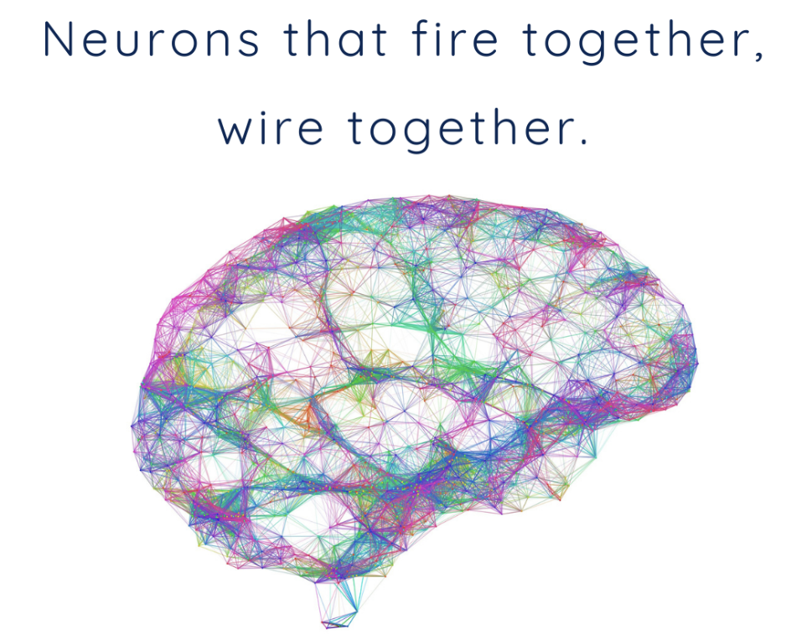
Neural Networks: How Everything Connects
Redes neuronales: Cómo todo está conectado
Las neuronas que se activan juntas se conectan entre sí
Neurons RARELY work alone
Las neuronas rara vez trabajan solas
They form circuits and networks for complex tasks
Forman circuitos y redes para realizar tareas complejas
Repeated activity strengthens connections between neurons → neural plasticity
La actividad repetida fortalece las conexiones entre las neuronas → plasticidad neuronal
Ex: Motor learning (how to play an instrument) | Ej.: Aprendizaje motor (cómo tocar un instrumento)
Ex: Habit formation | Ej.: Formación de hábitos
What do you think is more important, the individual neurons or the connections between them? Why?
¿Qué crees que es más importante, las neuronas individuales o las conexiones entre ellas? ¿Por qué?
Notes:
looking at the bigger picture
both matter, but the connections between the neurons are generally considered more important for explaining thought, memory, and behavior. Meaning comes from connections, not just from single cells. A single neuron can fire by itself, but it does not represent much on its own. What matters is when thousands or millions of neurons fire together in patterns.
These connections determine the flow of information and which neurons talk to which other neurons, which ultimately shapes perception, decision making, and learning
Learning also happens in these connections because the brain primarily learns by changing synaptic strength. Experiences don’t change the the number of neurons, but rather how they connect to each other.

Slide 18

Neurotransmitters and Hormones
Neurotransmisores y hormonas
Chemical Messengers of the Body
Mensajeros químicos del cuerpo

Slide 19
Neurotransmitters and Hormones: The Body’s Two Languages
Neurotransmisores y hormonas: los dos lenguajes del cuerpo
Both affect behavior, but in different ways
Ambos afectan el comportamiento, pero de maneras diferentes.
Neurotransmitters
Neurotransmisores
Hormones
Hormonas
Fast, Targeted messages in the nervous system
Mensajes, rápidos y específicos en el sistema nervioso
Slow, Widespread messages in the endocrine system
Mensajes, lentos y generalizados en el sistema endocrino

Slide 20
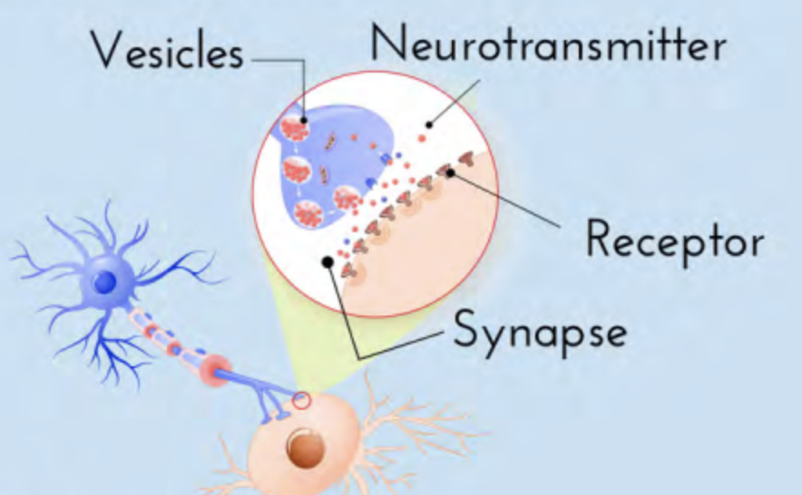
Understanding Neurotransmitters
Comprender los neurotransmisores
What are they? | ¿Qué son?
Chemicals released by neurons at the synapse that influence the next cell.
They can excite (activate) or inhibit (reduce activity) other neurons.
Son sustancias químicas liberadas por las neuronas en la sinapsis que influyen en la célula vecina.
Pueden excitar (activar) o inhibir (reducir la actividad) otras neuronas.
Neurotransmisor
Vesículas
Receptor
Sinapsis

Slide 21
Understanding Neurotransmitters
Comprender los neurotransmisores
Dopamine | Dopamina
Motivation, reward, movement , Involved in pleasure and habit learning
Motivación, recompensa, movimiento, Implicado en el placer y el aprendizaje de hábitos
Glutamate | Glutamato
Main excitatory neurotransmitter, Learning and memory
Neurotransmisor excitatorio principal, Aprendizaje y memoria
Serotonin | Serotonina
Mood, sleep, appetite, emotional stability, Low levels associated with depression
Estado de ánimo, sueño, apetito, estabilidad emocional, Los niveles bajos se asocian con la depresión
GABA
Main inhibitory neurotransmitter, Calms the nervous system
Principal neurotransmisor inhibidor, Calma el sistema nervioso
Acetylcholine (ACh) | Acetilcolina
Learning and memory, Muscle movement
Aprendizaje y memoria, Movimiento muscular
Notes:
Low dopamine = Parkinson’s
High dopamine = linked to schizophrenia
Low GABA = anxiety and seizures
High glutamate = seizures or overstimulation
Low ACh = ties to alzheimer's

Slide 22
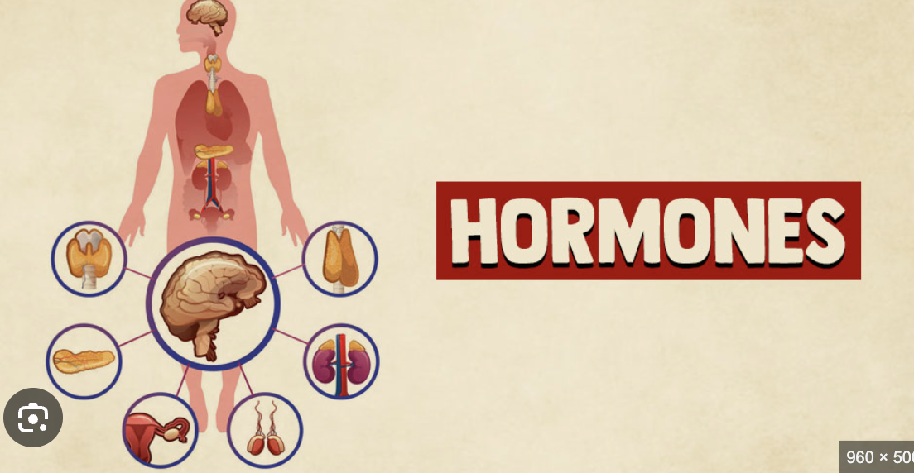
Understanding Hormones
Comprender las hormonas
What are they? | ¿Qué son?
Chemical messengers that are released by glands in the endocrine system into the bloodstream.
Influence mood, growth, metabolism, stress, reproduction, and more
Son mensajeros químicos liberados por las glándulas del sistema endocrino al torrente sanguíneo.
Influyen en el estado de ánimo, el crecimiento, el metabolismo, el estrés, la reproducción y mucho más.
Notes:
Neurotransmitters work in seconds, but on the other hand, hormones can affect behavior over minutes, hours, and even years
Because they travel in the blood, their effects are slower, longer lasting, and more widespread

Slide 23
Understanding Hormones
Comprender las hormonas
Adrenaline (Epinephrine) | Adrenalina (Epinefrina)
Released during stress/emergencies, Increases heart rate, energy, alertness
Se libera en situaciones de estrés o emergencias, Aumenta la frecuencia cardíaca, la energía y el estado de alerta
Oxytocin | Oxitocina
Bonding, trust, social connection, Released during hugging, childbirth, positive experiences
Vínculo, confianza, conexión social, Se liberan durante los abrazos, el parto y las experiencias positivas
Cortisol
The body’s main stress hormone, Helps respond to long term stress
La principal hormona del estrés del cuerpo, Ayuda a responder al estrés a largo plazo
Testosterone and Estrogen | Testosterona y estrógeno
Melatonin | Melatonina
Influence sexual development, mood, risk-taking, nurturing, aggression, Present in all genders but in different amounts
Influye en el desarrollo sexual, el estado de ánimo, la toma de riesgos, la crianza y la agresividad, Presente en todos los géneros, pero en diferentes grados
Regulates sleep-wake cycles, Darkness triggers release, suppressed by light
Regula los ciclos de sueño-vigilia, La oscuridad desencadena la liberación de la hormona, la cual es suprimida por la luz
Notes:
Neurotransmitters work in seconds, but on the other hand, hormones can affect behavior over minutes, hours, and even years
Because they travel in the blood, their effects are slower, longer lasting, and more widespread
adrenaline is part of the fight or flight response
High cortisol = anxiety, poor sleep, weakened immune system
screen time at night will delay melatonin = harder to sleep
puberty shifts emotion and behavior because your hormones will change dramatically

Slide 24
Neurotransmitters vs. Hormones
Neurotransmisores frente a hormonas
These two systems work together, shaping how we think, feel, and act
Estos dos sistemas trabajan conjuntamente, moldeando nuestra forma de pensar, sentir y actuar.
Feature | Funcionalidad | Neurotransmitters | Neurotransmisores | Hormones | Hormonas
System | Sistema | Nervous | Nervioso | Endocrine | Endocrino
Travel | Desplazamiento | Synapses | Sinapsis | Bloodstream | Torreno sanguíneo
Speed | Velocidad | Millisecond | Milisegundos | Seconds to Hours | De segundos a horas
Affected Area | Área afectada | Targeted | Dirigido | Widespread | Generalizado
Duration | Duración | Short | Corto | Long-lasting | De larga duración
Examples | Ejemplos | Dopamine, serotonin | Dopamina, serotonina | Cortisol, oxytocin | Cortisol, oxitocina

Slide 25
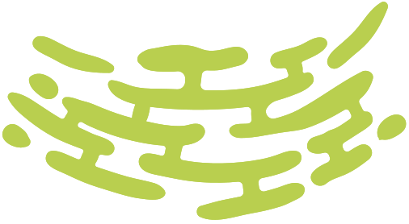

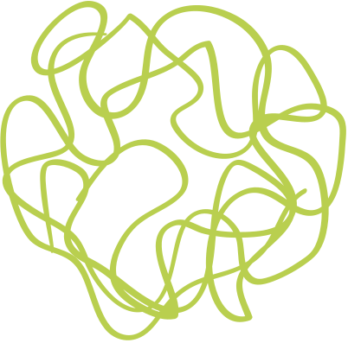
Nature, Nurture, and the Environment
La naturaleza, la crianza y el medio ambiente
Why We Behave the Way We Do
Por qué nos comportamos como lo hacemos

Slide 26
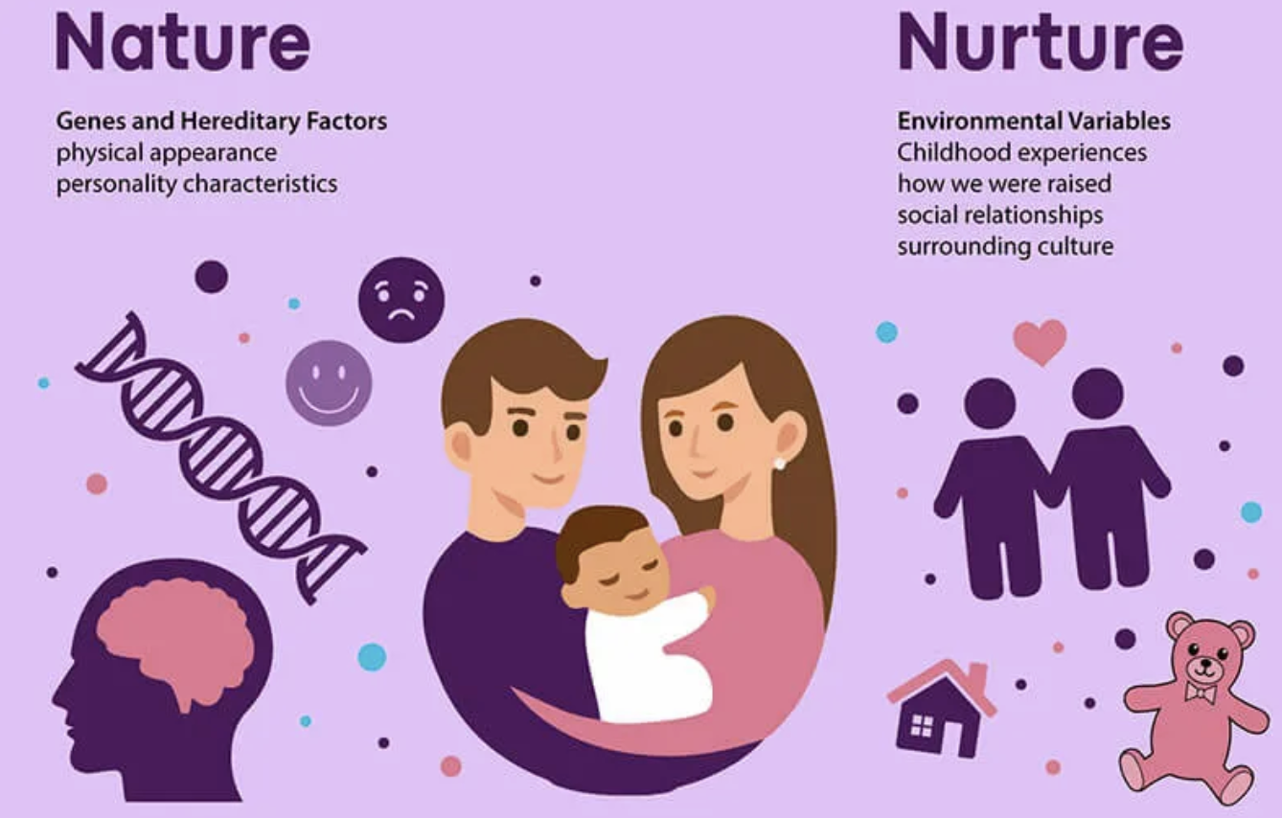
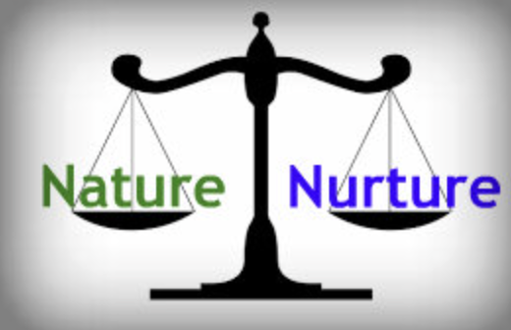
The Big Idea | La gran idea
Behavior = Biology (Nature) + Life Experiences (Nurture)
Comportamiento = Biología (Naturaleza) + Experiencias de vida (Crianza)
Neither work alone - it is a constant interaction that allows for the brain and the body to respond to BOTH genetics and environment
Ninguno de los dos funciona de forma aislada; se trata de una interacción constante que permite que el cerebro y el cuerpo respondan tanto a la genética como al entorno.
Naturaleza
Crianza
Genesy factores hereditarios
-Apariencia física
-Características de la
personalidad
Variables ambientales
- Experiencias de la infancia
-Cómo nos criaron
-Relaciones sociales
-Cultura circundante
Naturaleza
Crianza

Slide 27
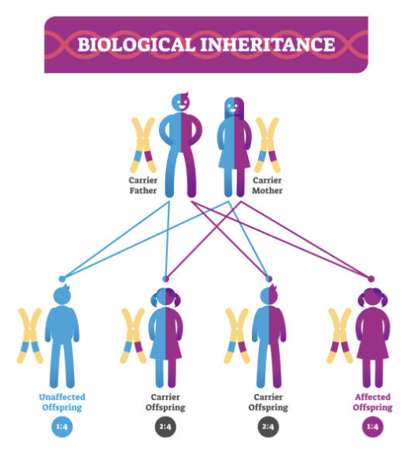
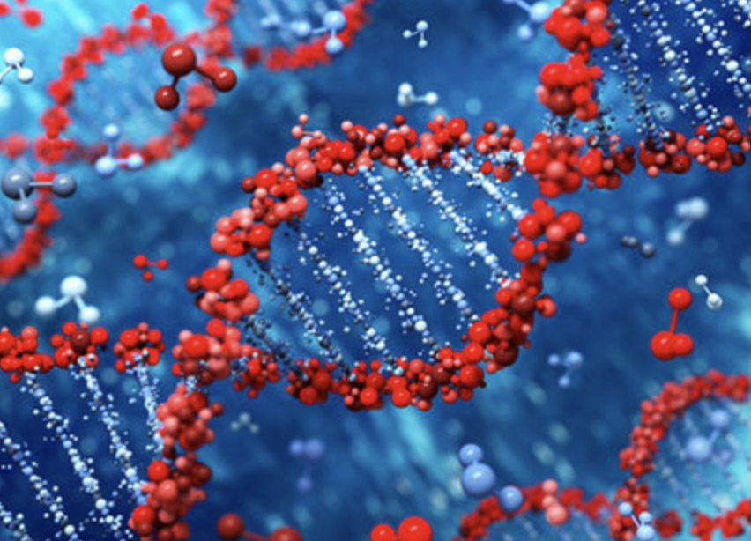
What is Nature? | ¿Qué es la naturaleza?
Nature builds the HARDWARE of behavior
La naturaleza construye el hardware del comportamiento
Nature = Biological Inheritance
Naturaleza = Herencia biológica

Slide 28
What is Nature? | ¿Qué es la naturaleza?
Genes: Instructions for building the body and the brain
Genetics, DNA, temperament
Genes: Instrucciones para la formación del cuerpo y el cerebro
Genética, ADN, temperamento
Brain structures: Influence memory, emotion, thinking
Estructuras cerebrales: Influyen en la memoria, las emociones y el pensamiento
Neurotransmitters: Fast chemical signals
Neurotransmisores: señales químicas rápidas
Hormones: slow, long-lasting body messages
Hormonas: mensajes corporales lentos y duraderos
Talent tendencies (athletics, music, math)
Talento innato (atletismo, música, matemáticas)
Biological predispositions to disorders
Talento innato (atletismo, música, matemáticas)
Predisposiciones biológicas a trastornos

Slide 29

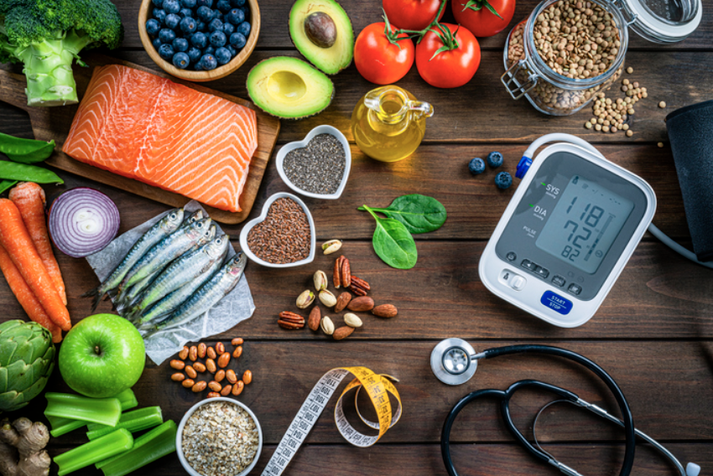

What is Nurture? | ¿Qué es la crianza?
Nurture is everything that happens after birth
La crianza abarca todo lo que sucede después del nacimiento
Experiences shape neural networks
Las experiencias moldean las redes neuronales

Slide 30
What is Nurture? | ¿Qué es la crianza?
Parenting, culture, schooling
Crianza, cultura, escolarización
Trauma and Support
Trauma y apoyo
Learning, practice, beliefs
Aprendizaje, práctica, creencias
Friends, social media, interactions
Amigos, redes sociales, interacciones
Nutrition, health, stress levels
Nutrición, salud, niveles de estrés

Slide 31

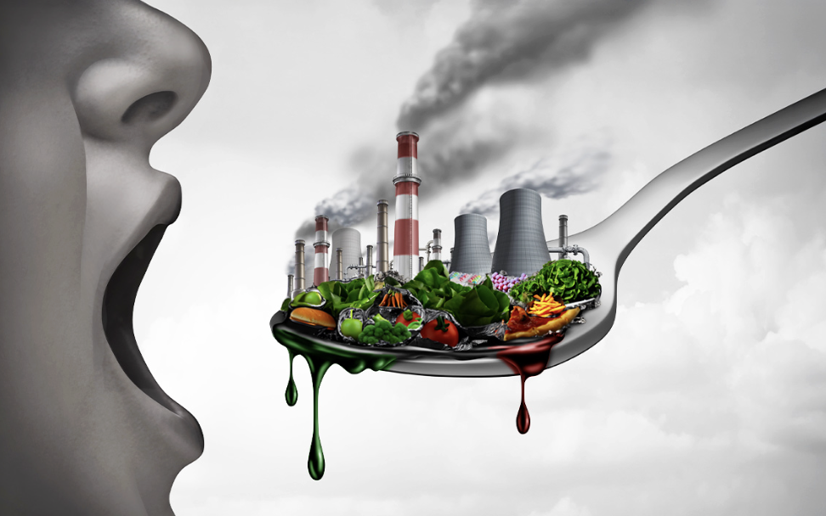
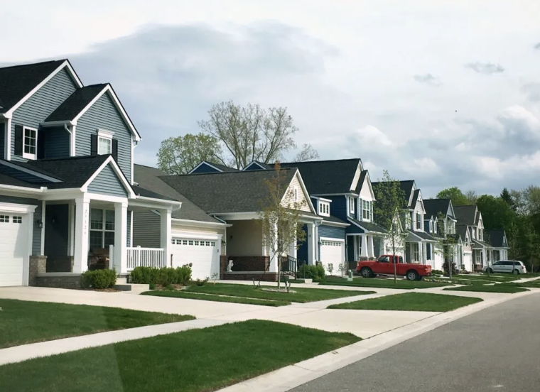
Environment: The Hidden Variable | Entorno: La variable oculta
Environment includes:
El medio ambiente incluye:
Neighborhood
Barrio
Socioeconomic status
Nivel socioeconómico
Diet, sleep
Dieta, sueño
Pollutants and toxins
Contaminantes y toxinas
Technology
Tecnología
The environment can alter brain chemicals, change gene expression, and shape neural pathways
El entorno puede alterar la química cerebral, modificar la expresión genética y moldear las vías neuronales

Slide 32
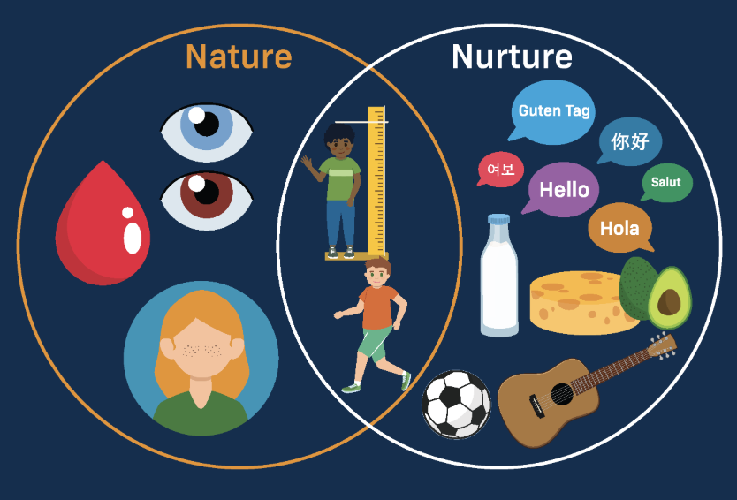
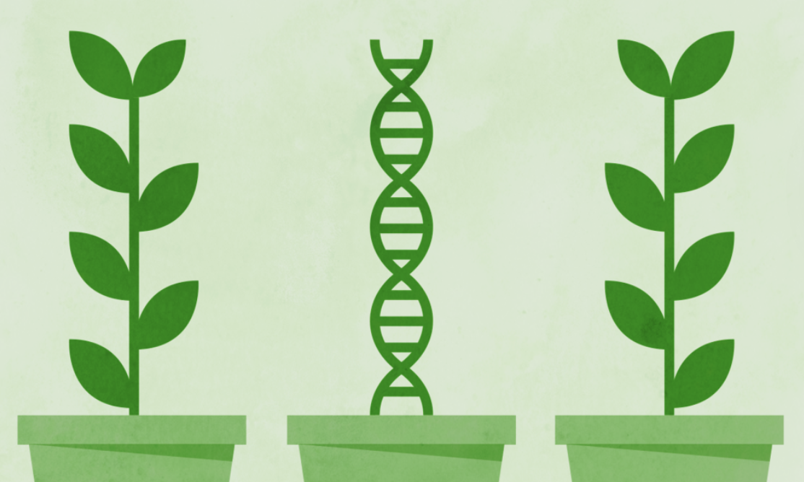
Nurture & Nature Interaction | Interacción entre crianza y naturaleza
The environment can turn genes on or off
El entorno puede activar o desactivar los genes
Examples | Ejemplos:
Stress can activate genes for anxiety
El estrés puede activar genes relacionados con la ansiedad.
Practice can override natural weaknesses
La práctica puede superar las debilidades naturales
Your life experiences can leave chemical marks on DNA that can pass to future generations
Tus experiencias vitales pueden dejar marcas químicas en el ADN que pueden transmitirse a las generaciones futuras

Slide 33
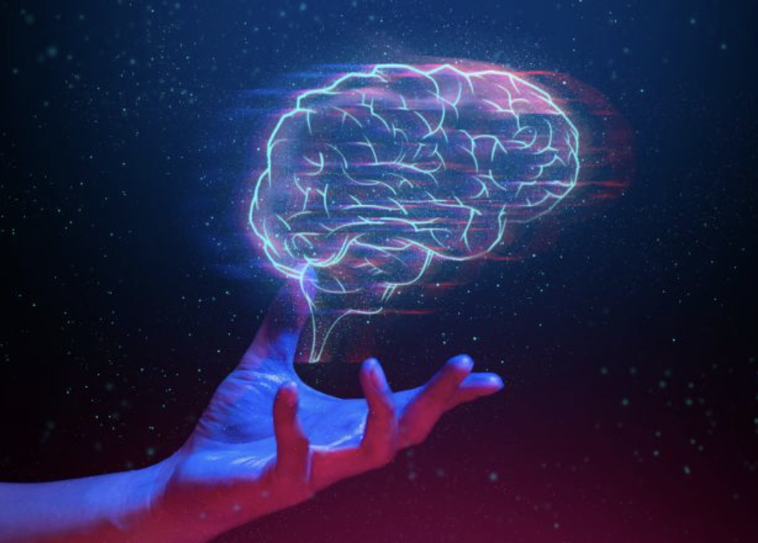
Why It Matters | Por qué es importante
Biology shapes our starting point
La biología determina nuestro punto de partida
Experiences shape our development
Las experiencias moldean nuestro desarrollo
The brain changes throughout life
El cerebro cambia a lo largo de la vida
You can rewire your brain with practice
Puedes reconfigurar tu cerebro con práctica
Nature and nurture are partners, not competitors
La naturaleza y la crianza se complementan, no compiten
You are not defined by nature or nurture – you are shaped by both
No te define la naturaleza ni la crianza; te moldean ambas

Slide 34
Who Am I | ¿Quién soy yo?
Students will receive a list of 25 personality and behavior traits (examples: creative, risk-taker, calm under pressure, procrastinator, competitive, empathetic, organized, impulsive)
Los estudiantes recibirán una lista de 25 rasgos de personalidad y comportamiento (ejemplos: creativo, arriesgado, tranquilo bajo presión, procrastinador, competitivo, empático, organizado, impulsivo)
Each student selects five traits they believe describe them well.
Cada estudiante selecciona cinco características que, en su opinión, los describen bien
For each chosen trait, students label it as:
Para cada característica elegida, los estudiantes la clasifican como:
N – Nature (genetics/biology) | N – Naturaleza (genética/biología)
U – Nurture (environment, upbringing, experiences) | U – Crianza (entorno, educación, experiencias)
B – Both nature and nurture | B – Tanto naturaleza como crianza

Slide 35
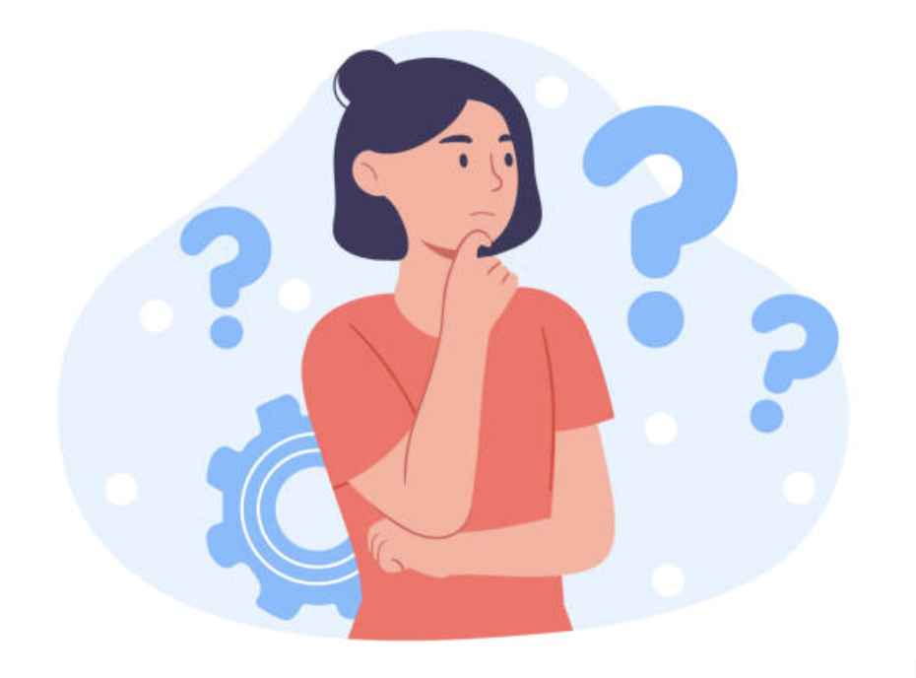
Who Am I | ¿Quién soy yo?
Students write 1–2 sentences explaining why they chose that label for each trait.
Los estudiantes escriben una o dos oraciones explicando por qué eligieron esa clasificación para cada característica.
Students will pair up and share their traits and explanations, discussing similarities, differences, and reasoning.
Los estudiantes se emparejarán y compartirán sus características y explicaciones, comentando las similitudes, las diferencias y los motivos de sus elecciones.
Notes:
Optional
Whole-class discussion: Which traits were most often labeled Both? Why?
Written reflection: Which trait was hardest to label and why?

Slide 36
Proposed activities/ideas:
ruler reflex experiment
Brain hemisphere hat
https://ellenjmchenry.com/brain-hemisphere-hat/
Brain hemisphere puzzle
https://thecraftyclassroom.com/wp-content/uploads/2015/01/BrainPuzzle.pdf
nature vs. nurture personality assignment

Slide 37
Look into brain activity, compare slides to animal brains in jars
Potentially cut neurons and neurotransmitters down to a couple slides.
Talk about how parts of the brain overlap, somatic system can impact autonomic system (box breathing activity)
Drunk goggles
twin studies for nature and nutrue

